Slide 1
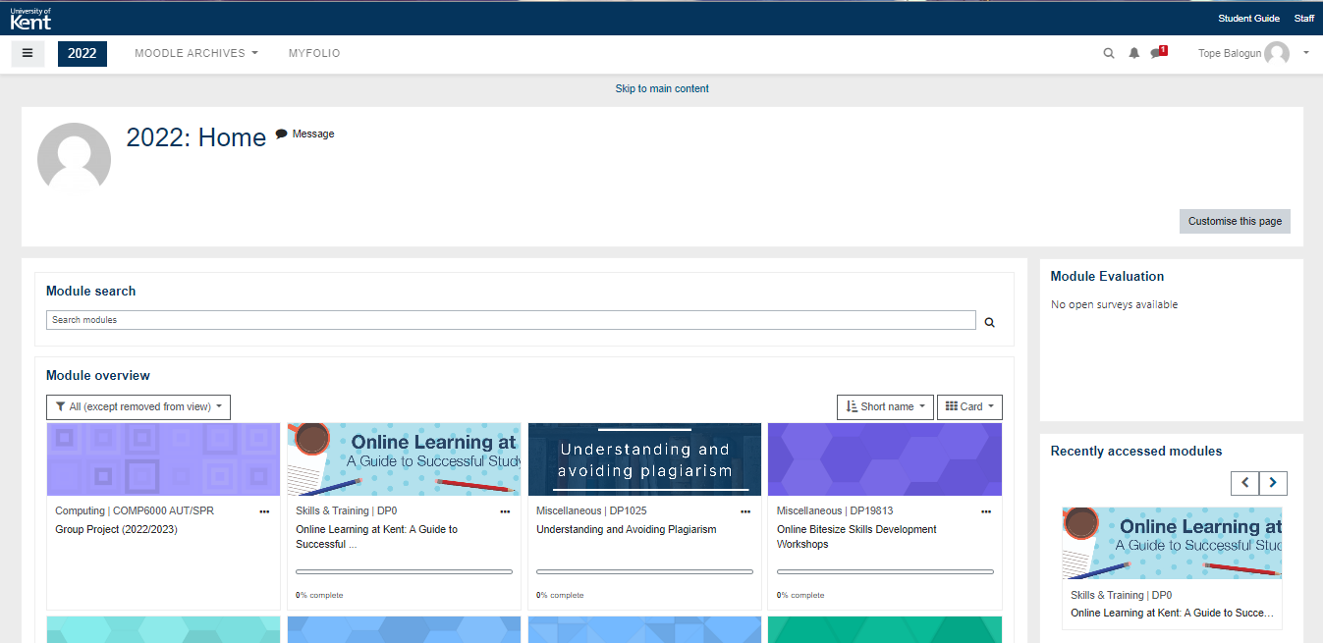
Youdle ++

Slide 2


YOUDLE++
Be great via Implicit learning
To make old traditional way of learning easier to absorb and interactive !
Lets get Started

Slide 3


YOUDLE++
Teachers Login
Student Login

Slide 4
YOUDLE++
Log in
Email
Password
Log in

Slide 5


YOUDLE++
Create Quiz
View Quiz

Slide 6
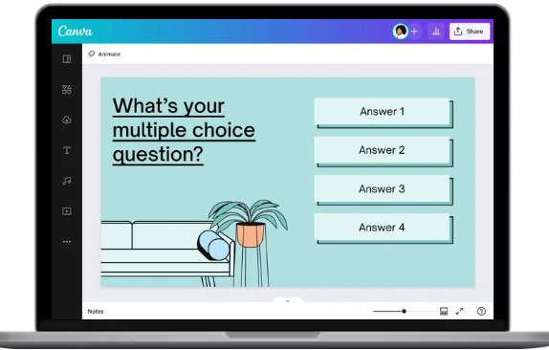
YOUDLE++
Create !

Slide 7
YOUDLE++
Teachers Login
Student Login

Slide 8
YOUDLE++
Log in
Email
Password
Log in

Slide 9
YOUDLE++
Create Quiz
View Quiz

Slide 10
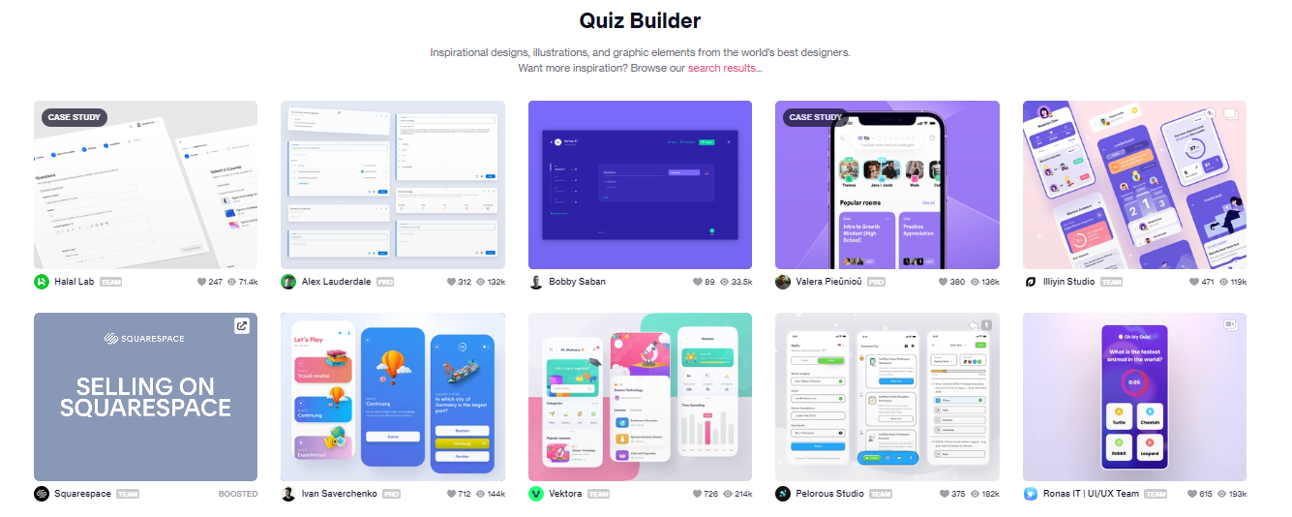
YOUDLE++

Slide 11





YOUDLE++
Insert Players
Add
Start!

Slide 12
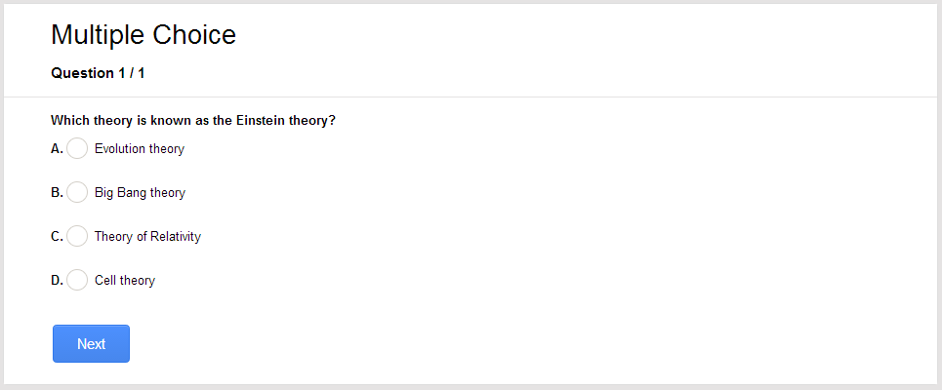
YOUDLE++
Question 1/5

Slide 13
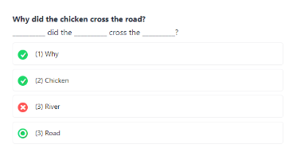
YOUDLE++
Question 2/5

Slide 14
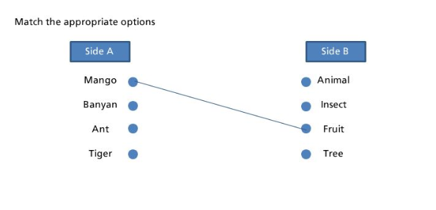
YOUDLE++
Question 3/5

Slide 15
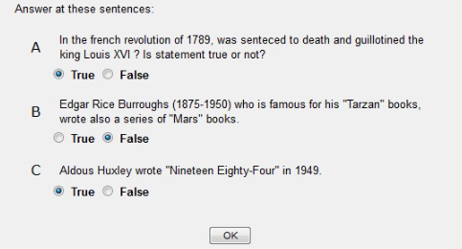
YOUDLE++
Question 4/5

Slide 16
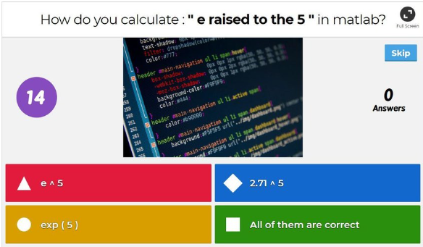
YOUDLE++
Question 5/5

